Slide 1



Use of NASA's GCMD keyword vocabulary transformed into SKOS structures in context of ISDC* ontology and IDN applications
The Electronic
Geophysical Year
Bernd Ritschel
GFZ ISDC* Manager and Information Scientist
rit@gfz-potsdam.de
Günther Neher
University of Applied Sciences Potsdam - Faculty of Information Science
g.neher@fh-potsdam.de
*Information System and Data Center

Slide 2
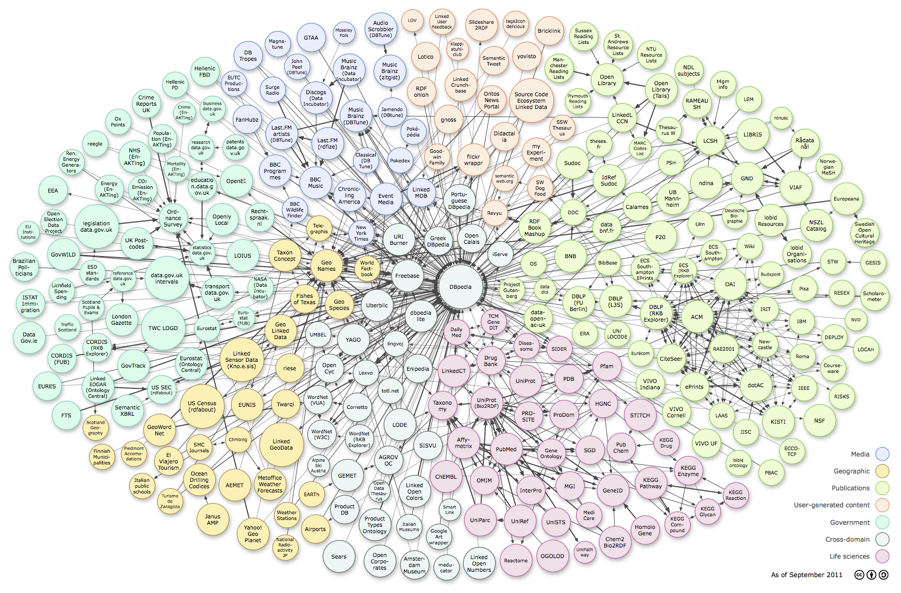
Linked (Open) Data Cloud
http://richard.cyganiak.de/2007/10/lod/lod-datasets_2011-09-19_colored.html

Slide 3
Controlled Vocabularies
Language Vocabulary
Semantics in a domain specific language
Formal languages
Programming languages
Markup languages
HTML
XML
RDF
OWL
GML (Geography ML)
KML (Keyhole ML)
…
Keyword Vocabulary
Semantics of terms and definitions in a domain
Indexes
Glossaries
Dictionaries
Taxonomies
Thesauri
GCMD science keywords
GCMD service keywords
…
Getty Thesaurus of Geographic Names
…

Slide 4
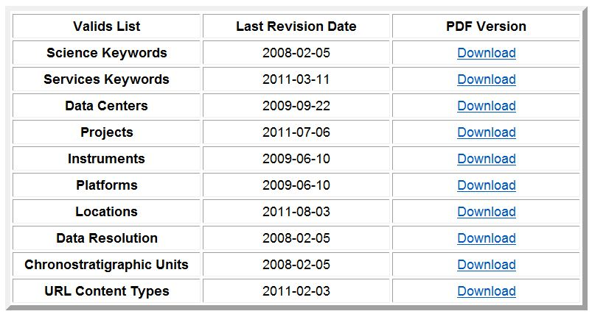
GCMD/IDN Keywords
http://gcmd.gsfc.nasa.gov/Resources/valids/archives/keyword_list.html

Slide 5
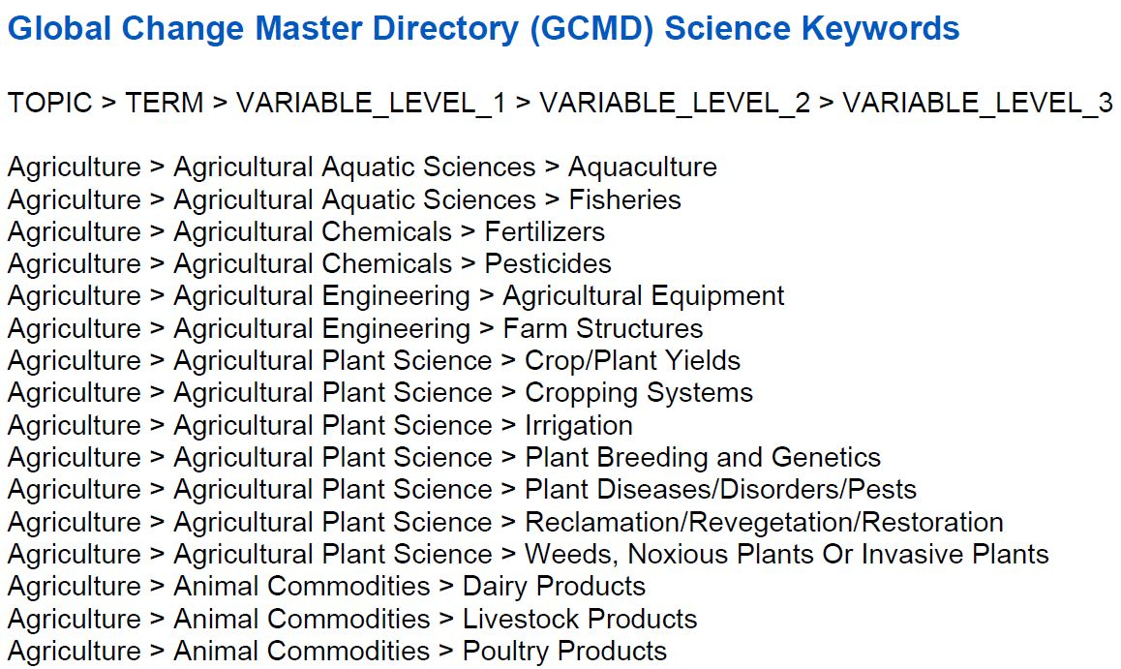
GCMD Science Keywords
http://gcmd.gsfc.nasa.gov/Resources/valids/archives/GCMD_Science_Keywords.pdf

Slide 6
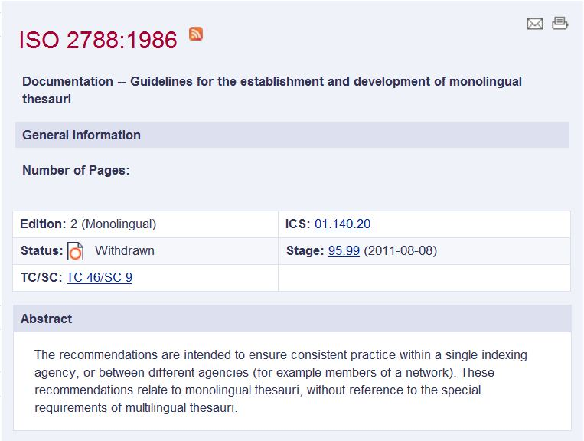
Thesauri* Standard
*Controlled vocabulary connected by relations
for indexing, tagging and information retrieval
http://www.iso.org/iso/iso_catalogue/catalogue_tc/catalogue_detail.htm?csnumber=7776

Slide 7
Thesaurus Language Vocabulary
Hierarchical relationships
narrower term [NT] = hyperonym (more general)
broader term [BT] = hyponym (more specific)
Equivalent relationships (for synonyms and near-synonyms)
use [USE]
used for [UF]
preferred term [PT] = authorized descriptor for the concept
Associate relationships (for other relationships then hierarchical or equivalent)
related term [RT]

Slide 8

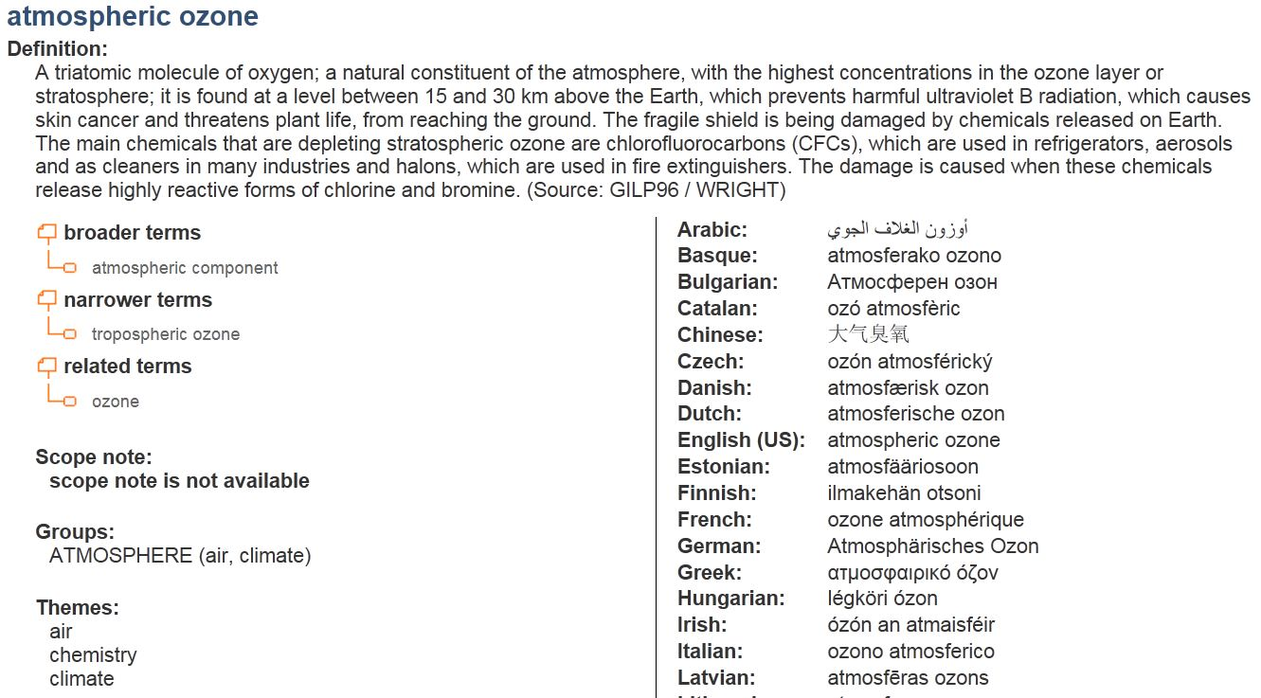
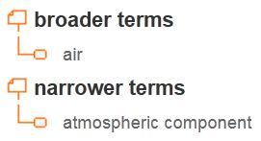
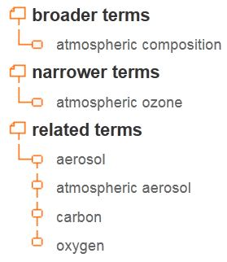
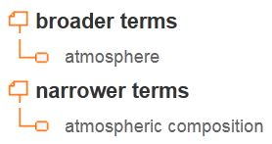
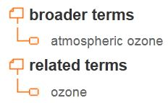
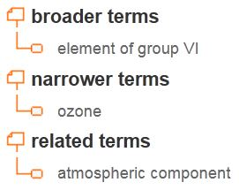
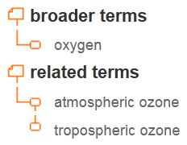
Concept Atmosperic Ozone
http://www.eionet.europa.eu/gemet/concept?cp=632&langcode=en&ns=1

Slide 9

GCMD: Concept Ozone
BT
BT
NT
NT
RT
BT
BT
BT
NT
NT
NT
http://gcmd.gsfc.nasa.gov/Resources/valids/archives/GCMD_Science_Keywords.pdf

Slide 10

SKOS
http://www.w3.org/2004/02/skos/
Simple Knowledge Organization System
RDF/RDFS based formal language
for thesauri, taxonomies, classifications, …
in the framework of the Semantic Web
http://www.w3.org/TR/2009/REC-skos-reference-20090818/

Slide 11
SKOS Model
the "concepts" (terms*) of a thesaurus or classification scheme are modeled as individuals in the SKOS data model,
and the informal descriptions about and links between those "concepts" (relations*) -as given by the thesaurus or classification scheme- are modeled as facts (properties*) about those individuals
SKOS data are expressed as RDF triples
* added by B. Ritschel
http://www.w3.org/TR/2009/REC-skos-reference-20090818/

Slide 12
SKOS Namespace and Vocab
Namespace URI
http://www.w3.org/2004/02/skos/core#
Vocabulary (excerpt)
skos:Concept (idea, notion, term)
Skos:definition (definition)
skos:broader (BT)
skos:narrower (NT)
skos:prefLabel (preferred string)
skos:altLabel (alternate string)
skos:related (RT)
skos:exactMatch (RT in different concept schemes)
skos:closeMatch (RT in different concept schemes)

Slide 13
GCMD Science Keywords 1/7
<?xml version="1.0"?>
<!DOCTYPE rdf:RDF [
<!ENTITY owl "http://www.w3.org/2002/07/owl#" >
<!ENTITY xsd "http://www.w3.org/2001/XMLSchema#" >
<!ENTITY owl2xml "http://www.w3.org/2006/12/owl2-xml#" >
<!ENTITY skos "http://www.w3.org/2004/02/skos/core#" >
<!ENTITY rdfs "http://www.w3.org/2000/01/rdf-schema#" >
<!ENTITY rdf "http://www.w3.org/1999/02/22-rdf-syntax-ns#" >
]>
<rdf:RDF
xml:base="http://localhost/gcmdscience"
xmlns:rdfs="http://www.w3.org/2000/01/rdf-schema#"
xmlns:owl2xml="http://www.w3.org/2006/12/owl2-xml#"
xmlns:owl="http://www.w3.org/2002/07/owl#"
xmlns:xsd="http://www.w3.org/2001/XMLSchema#"
xmlns:rdf="http://www.w3.org/1999/02/22-rdf-syntax-ns#"
xmlns:skos="http://www.w3.org/2004/02/skos/core#">
<owl:Ontology rdf:about=""/>
Juliane Pilgrim,
University of Applied Sciences Potsdam - Faculty of Information Science

Slide 14
GCMD Science Keywords 2/7
<!--Object Properties-->
<owl:ObjectProperty rdf:about="&skos;inScheme"/>
<owl:ObjectProperty rdf:about="&skos;narrower"/>
<owl:ObjectProperty rdf:about="&skos;topConceptOf"/>
<!-- Data properties -->
<owl:DatatypeProperty rdf:about="&skos;prefLabel"/>
<! -- Classes -->
<owl:Class rdf:about="&owl;Thing"/>
<owl:Class rdf:about="&skos;Concept"/>
<owl:Class rdf:about="&skos;ConceptScheme"/>

Slide 15
GCMD Science Keywords 3/7
<!-- Individuals -->
<owl:Thing rdf:about="#002.002.008">
<rdf:type rdf:resource="&skos;Concept"/>
<skos:prefLabel rdf:datatype="&rdf;XMLLiteral" xml:lang="en">
Tropospheric Ozone</skos:prefLabel>
<skos:inScheme rdf:resource="#gcmdscience"/>
</owl:Thing>
<owl:Thing rdf:about="#002.004.005.002">
<rdf:type rdf:resource="&skos;Concept"/>
<skos:prefLabel rdf:datatype="&rdf;XMLLiteral" xml:lang="en">Ozone
</skos:prefLabel>
<skos:inScheme rdf:resource="#gcmdscience"/>
</owl:Thing>
…

Slide 16
GCMD Science Keywords 4/7
<!-- Individuals -->
<owl:Thing rdf:about="#002">
<rdf:type rdf:resource="&skos;Concept"/>
<skos:prefLabel rdf:datatype="&rdf;XMLLiteral" xml:lang="en">Atmosphere
</skos:prefLabel>
<skos:narrower rdf:resource="#002.001"/>
<skos:narrower rdf:resource="#002.002"/>
<skos:narrower rdf:resource="#002.003"/>
<skos:narrower rdf:resource="#002.004"/>
<skos:narrower rdf:resource="#002.005"/>
<skos:narrower rdf:resource="#002.006"/>
<skos:narrower rdf:resource="#002.007"/>
<skos:narrower rdf:resource="#002.008"/>
<skos:narrower rdf:resource="#002.009"/>
<skos:narrower rdf:resource="#002.010"/>
<skos:narrower rdf:resource="#002.011"/>
<skos:narrower rdf:resource="#002.012"/>
<skos:narrower rdf:resource="#002.013"/>
<skos:inScheme rdf:resource="#gcmdscience"/>
Aerosols
Air Quality
Altitude
Atmospheric Chemistry
Atmospheric Electricity
Atmospheric Phenomena
Atmospheric Pressure
Atmospheric Radiation
Atmospheric Temperature
Atmospheric Water Vapor
Atmospheric Winds
Clouds
Precipitation

Slide 17
GCMD Science Keywords 5/7
<owl:Thing rdf:about="#002.002">
<rdf:type rdf:resource="&skos;Concept"/>
<skos:prefLabel rdf:datatype="&rdf;XMLLiteral" xml:lang="en">Air Quality
</skos:prefLabel>
<skos:narrower rdf:resource="#002.002.001"/>
<skos:narrower rdf:resource="#002.002.002"/>
<skos:narrower rdf:resource="#002.002.003"/>
<skos:narrower rdf:resource="#002.002.004"/>
<skos:narrower rdf:resource="#002.002.005"/>
<skos:narrower rdf:resource="#002.002.006"/>
<skos:narrower rdf:resource="#002.002.007"/>
<skos:narrower rdf:resource="#002.002.008"/>
<skos:narrower rdf:resource="#002.002.009"/>
<skos:narrower rdf:resource="#002.002.010"/>
<skos:narrower rdf:resource="#002.002.011"/>
<skos:inScheme rdf:resource="#gcmdscience"/>
</owl:Thing>
Carbon Monoxide
Emissions
Lead
Nitrogen Oxides
Particulates
Smog
Sulfur Oxides
Tropospheric Ozone
Trubidity
Visibility
Volatile Organic
Compounds
GCMD Science Keywords:

Slide 18
GCMD Science Keywords 6/7
<owl:Thing rdf:about="#002.004">
<rdf:type rdf:resource="&skos;Concept"/>
<skos:prefLabel rdf:datatype="&rdf;XMLLiteral" xml:lang="en">
Atmospheric Chemistry</skos:prefLabel>
<skos:narrower rdf:resource="#002.004.001"/>
<skos:narrower rdf:resource="#002.004.002"/>
<skos:narrower rdf:resource="#002.004.003"/>
<skos:narrower rdf:resource="#002.004.004"/>
<skos:narrower rdf:resource="#002.004.005"/>
<skos:narrower rdf:resource="#002.004.006"/>
<skos:narrower rdf:resource="#002.004.007"/>
<skos:narrower rdf:resource="#002.004.008"/>
<skos:narrower rdf:resource="#002.004.009"/>
<skos:inScheme rdf:resource="#gcmdscience"/>
</owl:Thing>
Carbon and Hydrocarbon
Compounds
Halocarbons and Halogens
Hydrogen Compounds
Nitrogen Compounds
Oxygen Compounds
Photochemistry
Sulfur Compounds
Trace Elements/
Trace Metals
Trace Gases/
Trace Species

Slide 19
GCMD Science Keywords 7/7
<owl:Thing rdf:about="#002.004.005">
<rdf:type rdf:resource="&skos;Concept"/>
<skos:prefLabel rdf:datatype="&rdf;XMLLiteral" xml:lang="en">
Oxygen Compounds</skos:prefLabel>
<skos:narrower rdf:resource="#002.004.005.001"/>
<skos:narrower rdf:resource="#002.004.005.002"/>
<skos:inScheme rdf:resource="#gcmdscience"/>
</owl:Thing>
Molecular Oxygen
Ozone
GCMD Science Keywords:

Slide 20
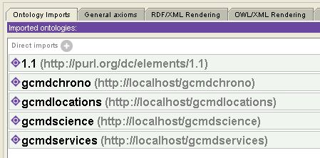
ISDC Ontology (Protégé 4.1)
<?xml version="1.0"?>
<rdf:RDF
xmlns:xsp="http://www.owl-ontologies.com/2005/08/07/xsp.owl#"
xmlns:swrlb="http://www.w3.org/2003/11/swrlb#"
xmlns:isdc="http://isdc.gfz-potsdam.de/ontology/isdc_1.0.owl#"
xmlns:swrl="http://www.w3.org/2003/11/swrl#"
xmlns:protege="http://protege.stanford.edu/plugins/owl/protege#"
xmlns:rdf="http://www.w3.org/1999/02/22-rdf-syntax-ns#"
xmlns:p1="http://purl.org/dc/elements/1.1#"
xmlns:xsd="http://www.w3.org/2001/XMLSchema#"
xmlns:rdfs="http://www.w3.org/2000/01/rdf-schema#"
xmlns:owl="http://www.w3.org/2002/07/owl#"
xmlns:dc="http://purl.org/dc/elements/1.1/"
xml:base="http://isdc.gfz-potsdam.de/ontology/isdc_1.0">

Slide 21
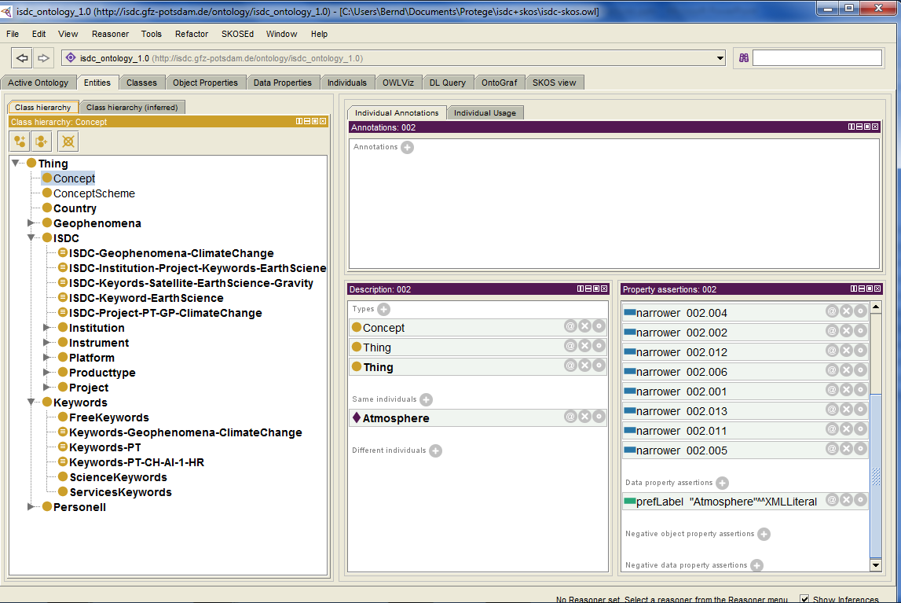
Live Demo (Protégé 4.1)
ISDC Ontology + SKOS structured
GCMD controlled keywords
http://isdc.gfz-potsdam.de/ontology/isdc_1.0.owl
gcmdchrono => chrono.skos.rdf
gcmdlocations => locations.skos.rdf
gcmdservices => services.skos.rdf
gcmdscience => science.skos.rdf

Slide 22
Some Ideas* for GCMD/IDN
Define own namespace: “gcmd” or “idn”
Using SKOS for GCMD’s controlled keywords
Providing GCMD’s controlled keywords as SKOS ontology via GCMD/IDN or PURL purl.org¹ URI
GCMD/IDN DIF (meta)data
Transform data to RDF
Create RDF triple store
Publish GCMD/IDN SPARQL endpoint in (Open) Linked Data cloud
Design GCMD/IDN ontology and use DC, FOAF, …
Link GCMD/IDN ontology vocab with Linked Data cloud vocabs and authority data (VIAF²)
¹Persistent Uniform Resource Locators
²http://viaf.org/
* We are using ISDC data for this approach

Slide 23
Added Information =>

Slide 24
What can be done with SKOS?
Stable, unique access point (URI) to the keywords
Expandable standard model for controlled keywords
Advantages of SKOS/RDF vocabulary:
Provide keywords to the (Semantic Web) community
Reuse of GCDM keywords in other domains
Connect keywords in a sustainable way to GCMD/IDN DIFs within an ontology environment
Query keywords using SPARQL
Connect related keywords with RT
Travel through the keywords (BT, NT)
Connect other SKOS keyword vocabularies on the Web
Keyword vocabulary is very easy expandable

Slide 25
What must be done?
Creating a GCMD/IDN URI
=> http://gcdm.nasa.gov/SKOS
Transforrm GCMD/IDN Keywords to SKOS/RDF structure
=> Done by GFZ Potsdam already for science, services, location and chronostratigraphic units keywords
Connect GCMD/SKOS keywords to DIF docs
1. Version: (parallel to the existing infrastructure)
DIF editing and retrieval tools using SKOS/RDF keywords
Create GCMD/IDN DIF ontology
=> Done by GFZ Potsdam for GFZ ISDC
Transform DIF entities => RDF data
2. Version: (parallel to the existing infrastructure)
Connect DIF/RDF data to SKOS/RDF keywords

Slide 26
Modeling/Programming Tasks
Modeling
Design GCDM/IDN ontology (e.g. with Protégé)
Design DIF individuals as RDF data fitting the ontology
Prepare use case based inference structures (e.g. portal dependent, …) in the ontology
Programming
Install RDF data store (e.g. Virtuoso)
Design script for DIF2RDF transformation
Import GCMD/IDN DIF/RDF data into RDF data store
Create GUI for data retrieval using SPARQL

Slide 27
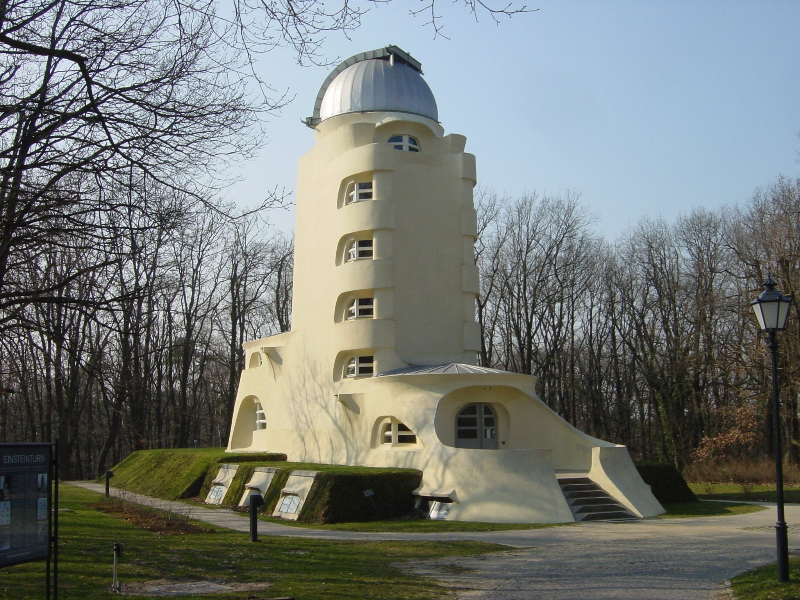

Einsteinturm (1921)
Thank you, Questions?

